Slide 1
SC2001 Lab 1
Team 4 LOW ZHAN QI, JODIUS
TAN SHIRLEY
AARON LIM WEE HIM

Slide 2
Table of contents
01
02
03
Hybrid Algorithm
Generate Input Data
Analysis –
Fixed S
04
05
06
Analysis –
Fixed n
Analysis - Optimal S
Compare
with Original

Slide 3
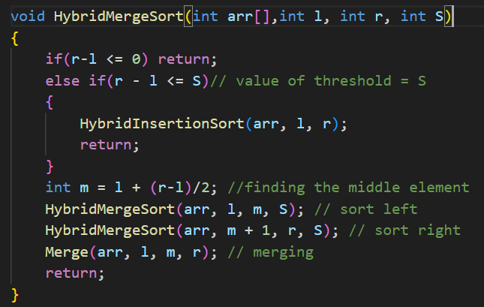
01 – Hybrid Algorithm
Programming Language: C
Will check for the arraysize if it is <= S
if <=S will continue with InsertionSort

Slide 4
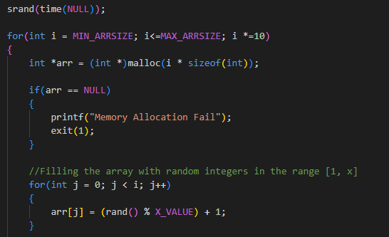
02 – Generate Input Data
5 input data cases (X_value = 10 mil)
1,000
10,000
100,000
1,000,000
10,000,000

Slide 5
03 - Theoretical Analysis
 | Best Case | Average Case | Worst Case
Insertion | n | n^2 | n^2
Merge | nlogn | nlogn | nlogn
Hybrid | n+nlog(n/s) | ns+nlog(n/s) | ns+nlog(n/s)
Total Time Complexity = Time complexity of Insertion Sort + Time complexity of Merge Sort

Slide 6
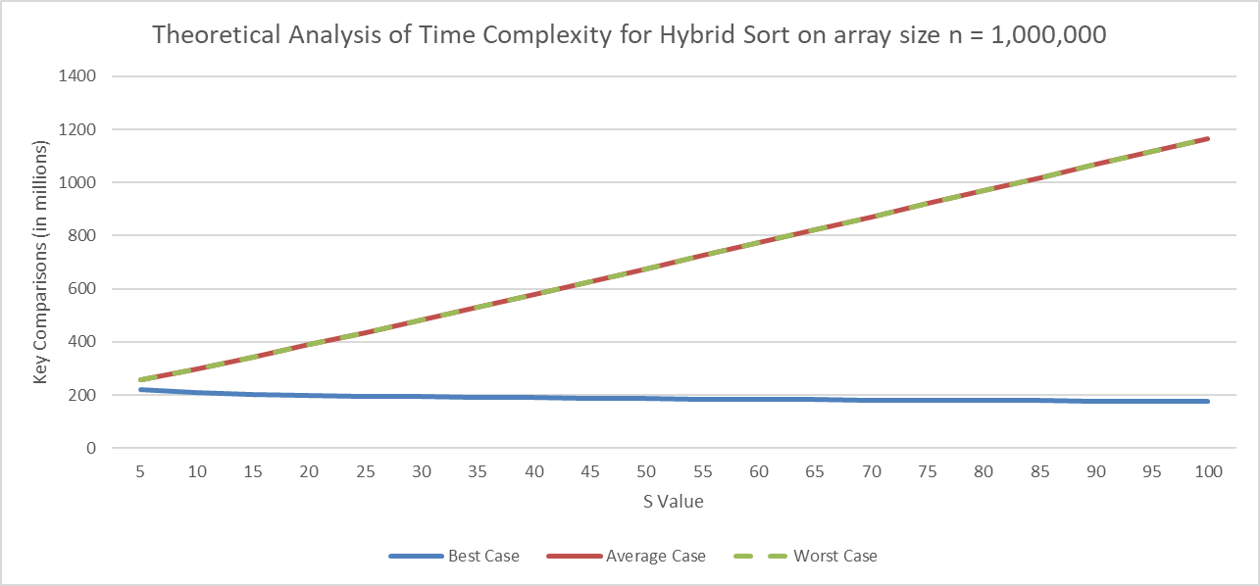
03 - Theoretical Analysis

Slide 7
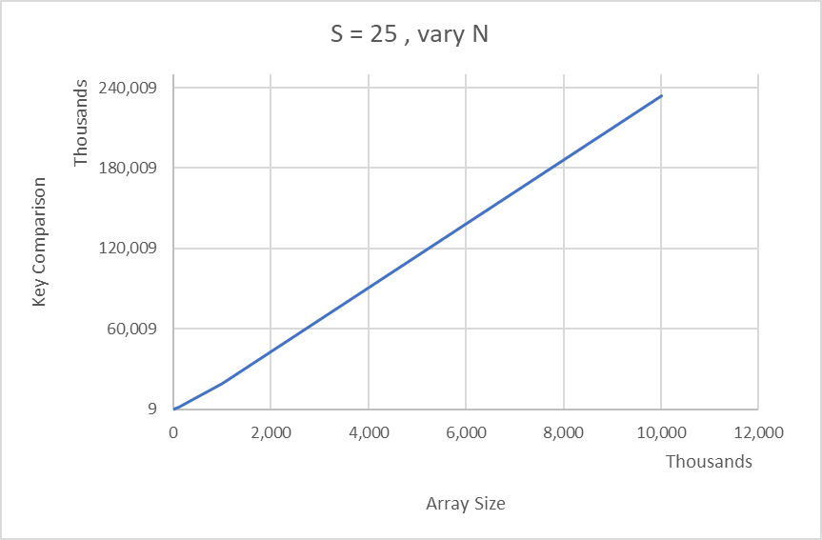
03 – Fixed threshold S
Array size increases, key comparison increases

Slide 8
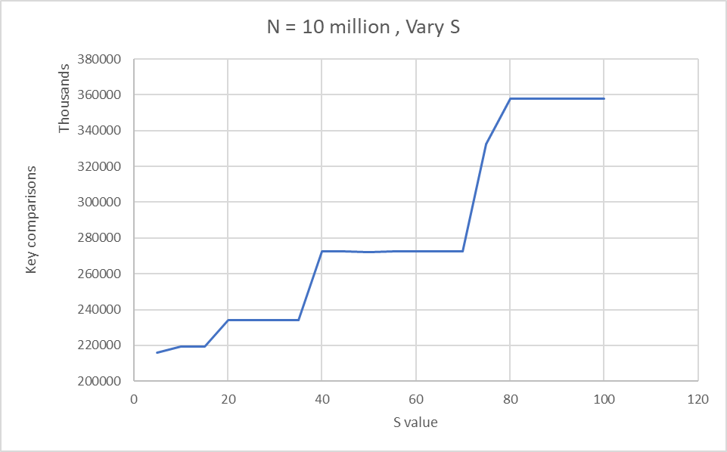
04 – Fixed Input Size n
Generally as S value increases, the number of key comparison increases as mergesort is being called recursively and insertion sort will have to iterate each and every sub array of the mergesort

Slide 9
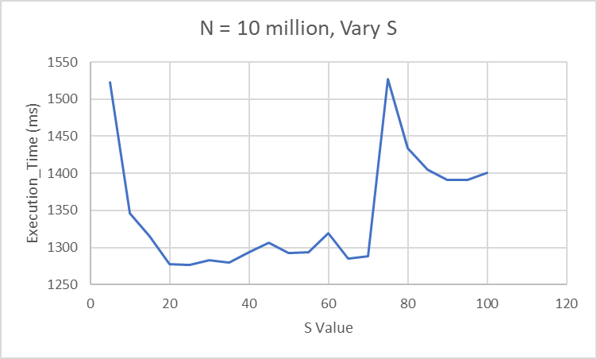
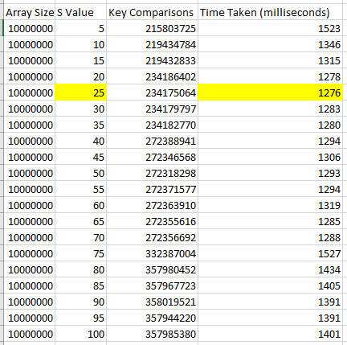
05 – Optimal Value of S
Optimal S value: 25
However the dataset generated are at random which is hard to specify a discrete value thus a range of 20 - 70 would be a better estimate for the S value.

Slide 10
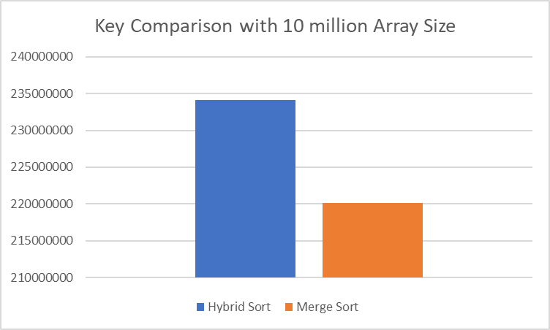
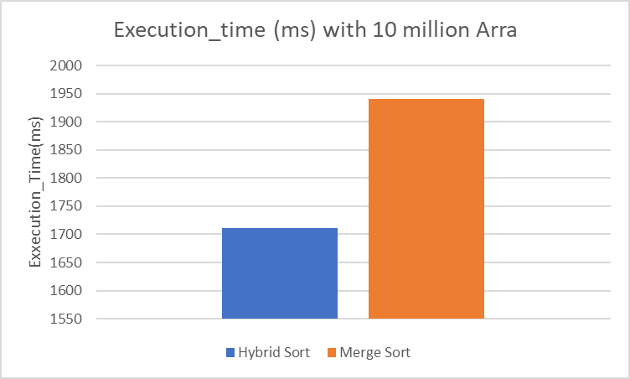
06 – Compare with Original Mergesort
Hybridsort has higher key comparison due to the insertionsort used on small sub array.
However, Hybridsort takes shorter execution time as it take lesser recursive calls.

Slide 11
Thank you

